Slide 1
Team 02
Interactive simulation of the composition of forces

Slide 2
Our Team
Trần Ngọc Dung
Đào Quang Dương
Nguyễn Đình Duy
20194742
20194747
20190096

Slide 3

All members working all tasks together including design class diagram, use case diagram, GUI design, package and class implementation, physics logic

Slide 4
Problem statement
Project create a simple interactive simulation for demonstrating Newton’s laws of motion.
The system includes three components: one main object, the surface, forces which apply to object.
The user can control all the components as:
+ Select the shape of the object by dragging and dropping it in the center of the screen
+ Click right mouse to open, close menu to change the parameters of object
+ Change the external force parameter
+ Change coefficient of friction
+ Checkbox in the upper corner to select the parameters you want to see details
+ pause, continue, and reset program
-> Program will calculate forces, sum of force, acceleration, current velocity, current position every 1 second.

Slide 5
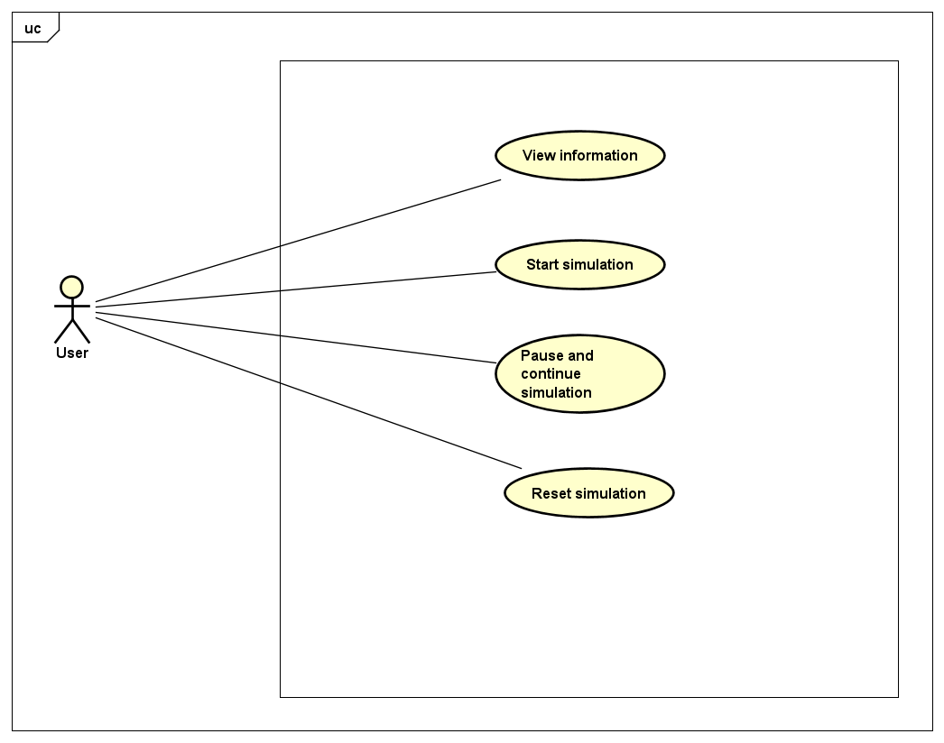
Use case diagram

Slide 6
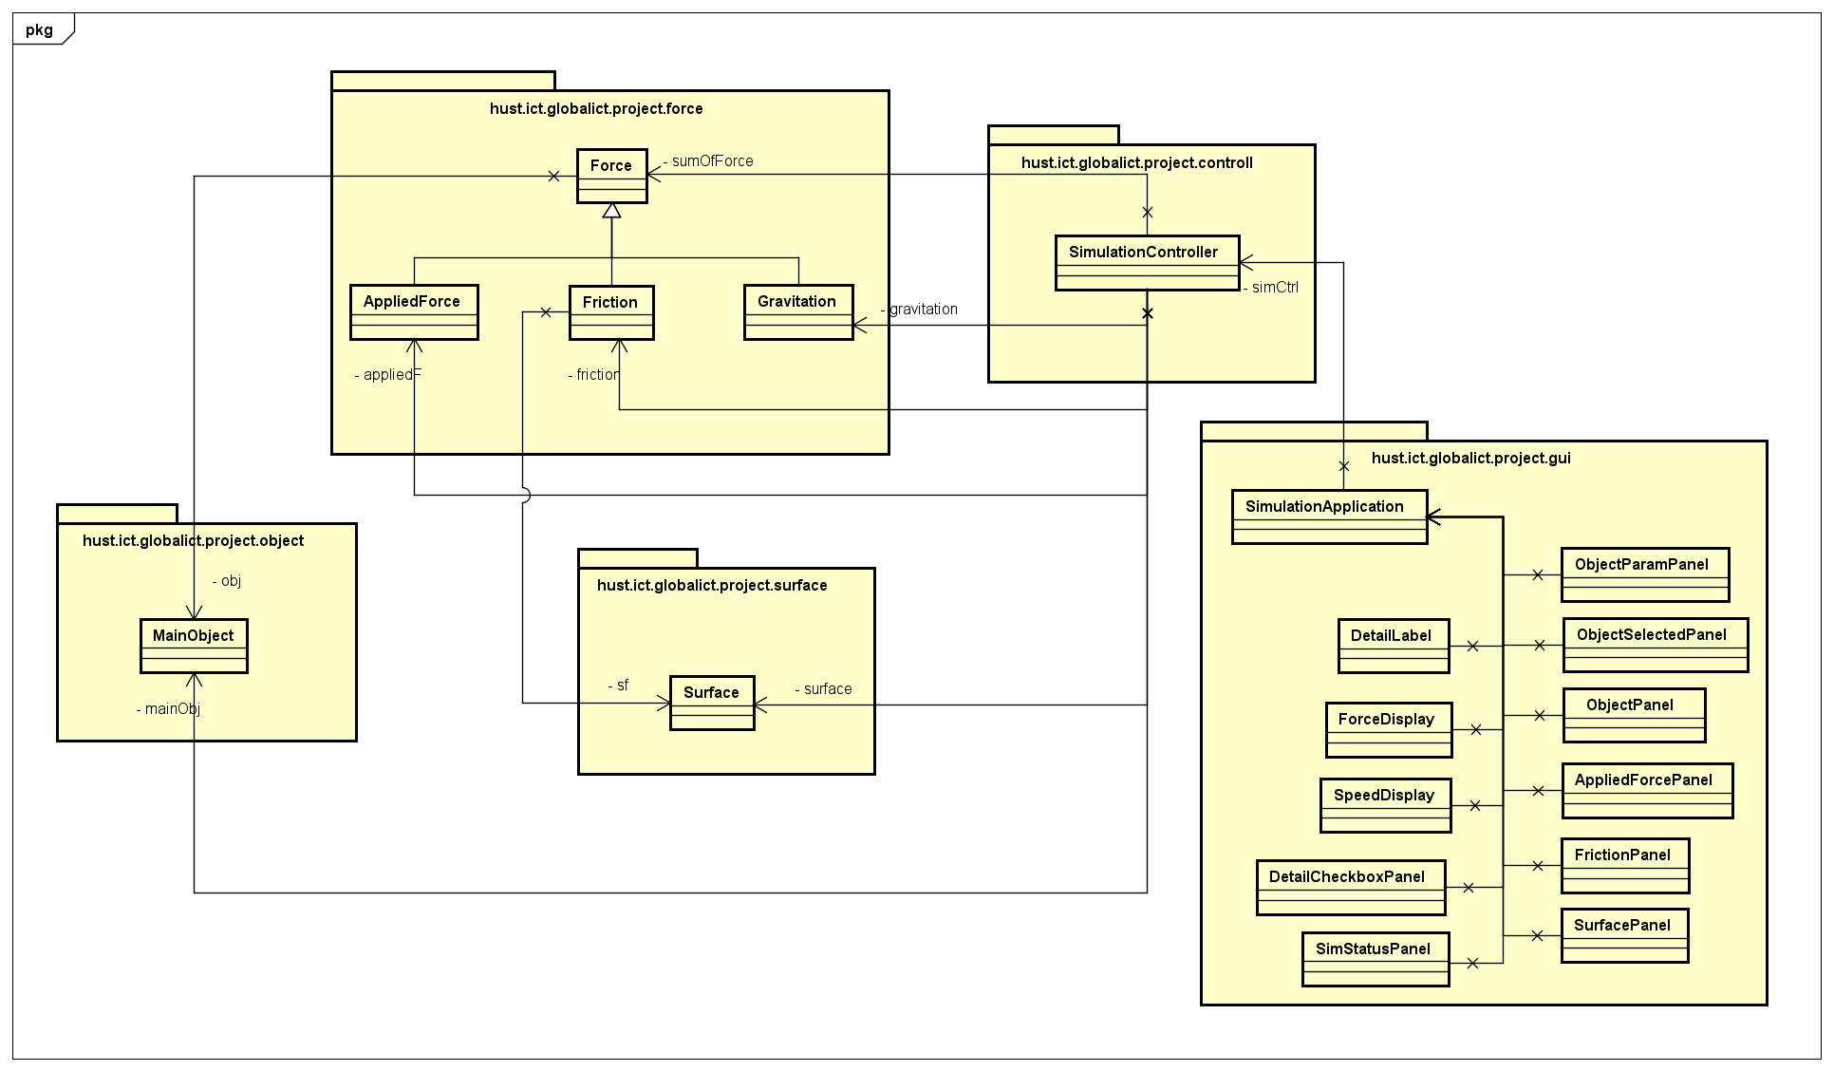
General class diagram

Slide 7
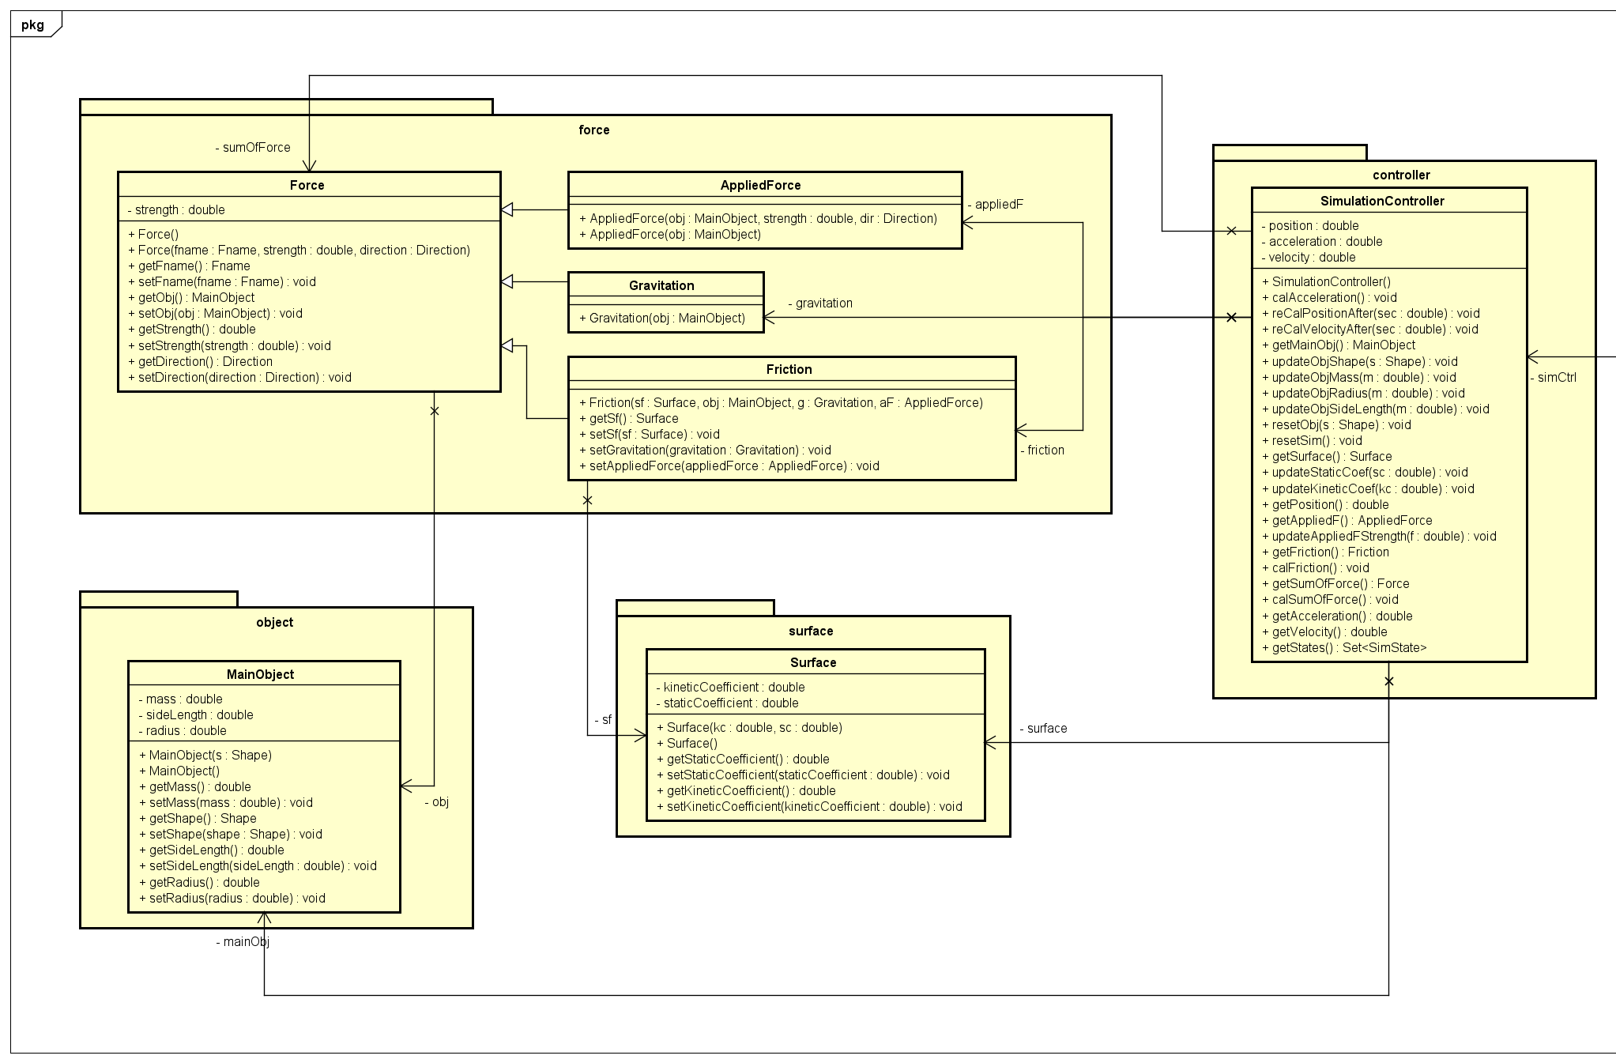
Detail class diagram

Slide 8
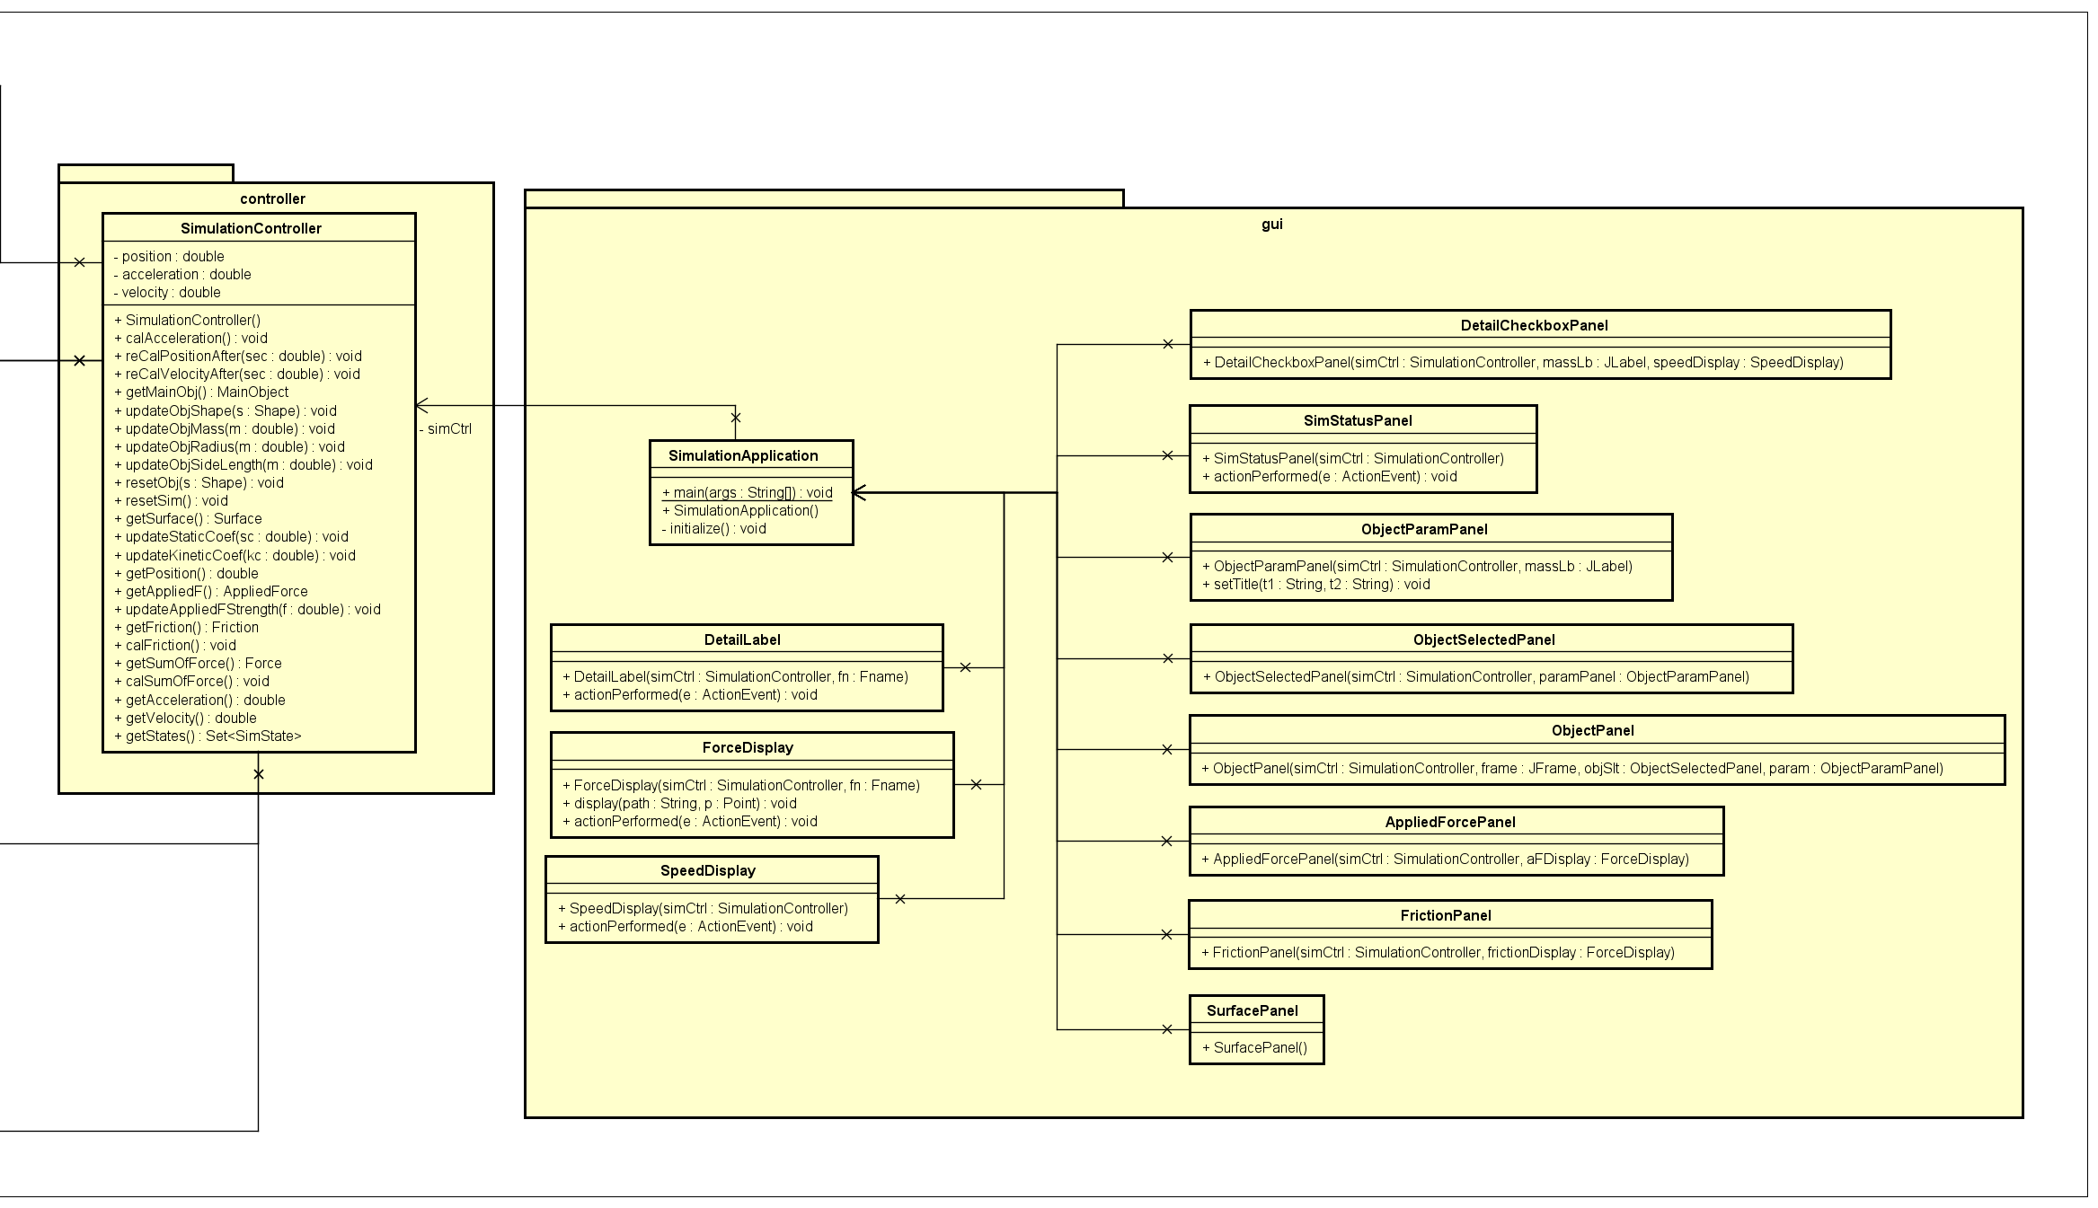
Detail class diagram

Slide 9
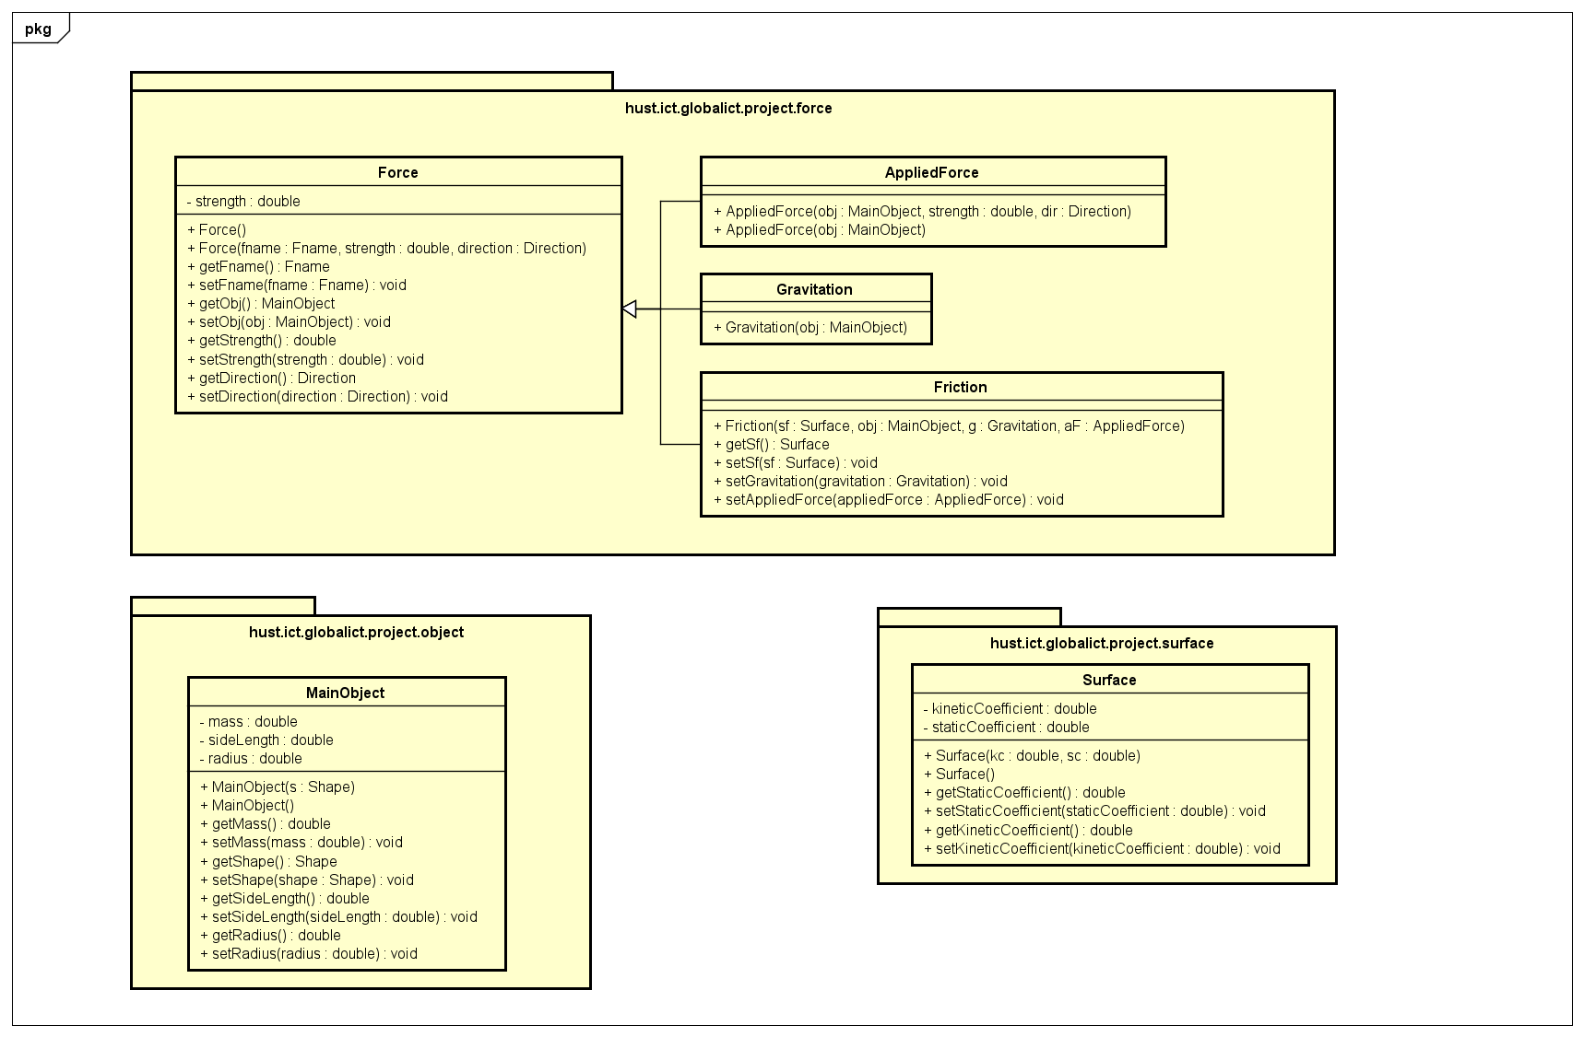
Model

Slide 10
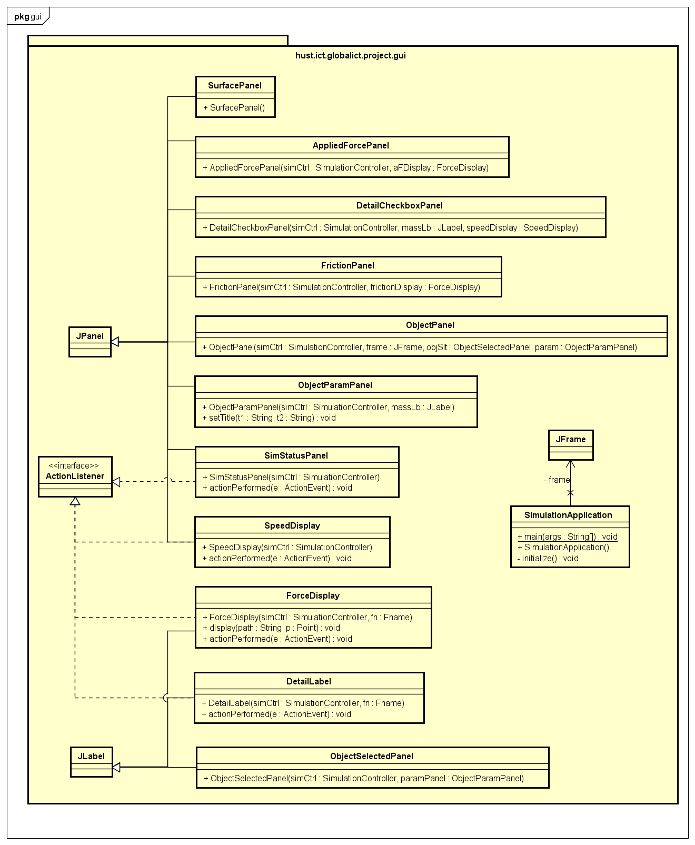
View

Slide 11
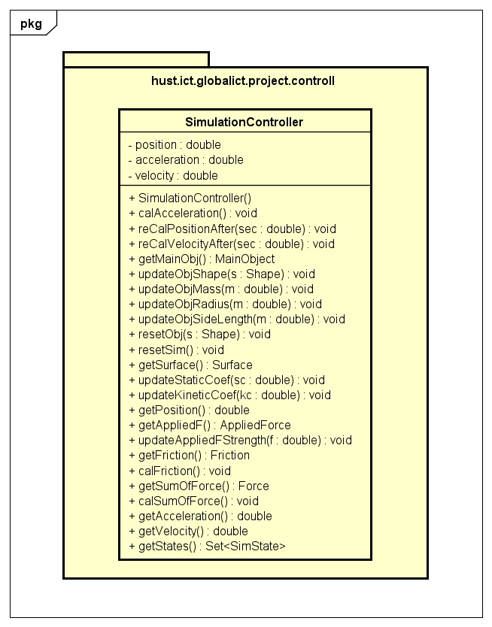
Controller

Slide 12
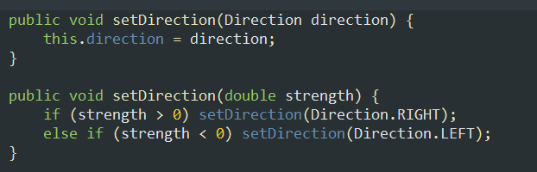
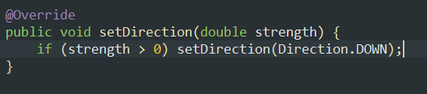
OOP techniques
Polymorphism
In Force class
In Gravitation class

Slide 13
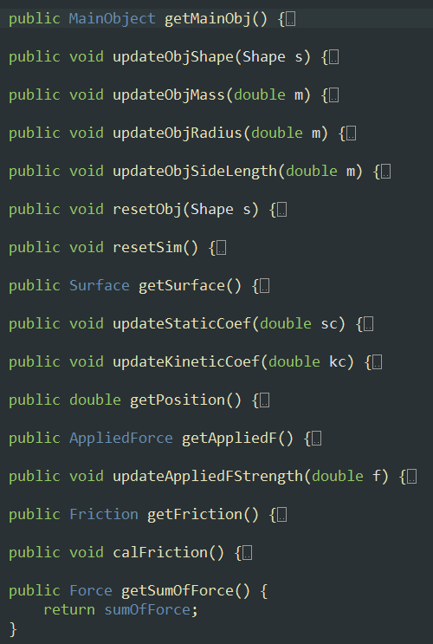
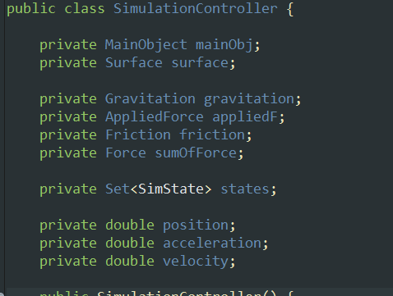
OOP techniques
Encapsulation
Keeping attribute private inside class​
Don’t access directly attribute, instead, call a list of public function – get, set, update

Slide 14
Association Class SimulationController and class MainObject (one-to-one) Class SimulationController and class Surface (one-to-one) Composition Class MainObject and class Force (one-to-many) Class Friction vs class Surface (one-to-one) Inheritance Class AppliedForce, Gravitation, and Friction inherit class Force
OOP techniques

Slide 15
Demo simulation

Slide 16

Thanks for listening!

